Slide 1
Applied Machine Learning and Data Mining
Week 3 Practical: What is DataFrame?
Dr. Alaa Mohasseb

Slide 2
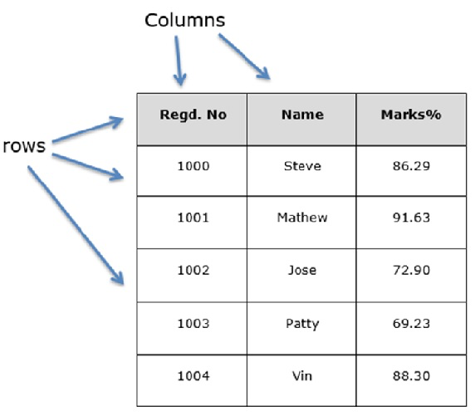
DataFrame
A Dataframe is a two-dimensional data structure, i.e., data is aligned in a tabular fashion in rows and columns.
Features of DataFrame
Potentially columns are of different types
Size – Mutable(changeble)
Labeled axes (rows and columns)
Can Perform mathematical operations on rows and column
it as an SQL table or a spreadsheet data representation.
Source:https://www.tutorialspoint.com/python_pandas/images/structure_table.jpg

Slide 3
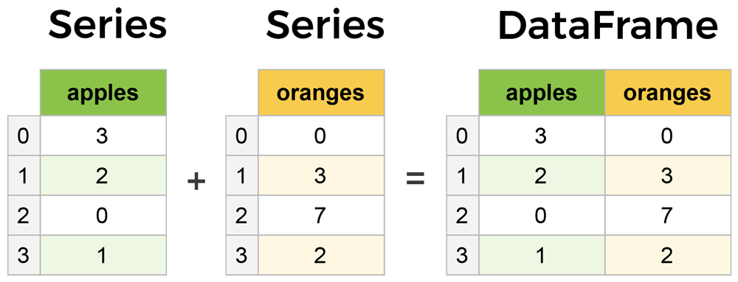
Core components of pandas: Series and DataFrames
The primary two components of pandas are the Series and DataFrame.
A Series is essentially a column, and a DataFrame is a multi-dimensional table made up of a collection of Series.
Source:series-and-dataframe.width-1200.png

Slide 4
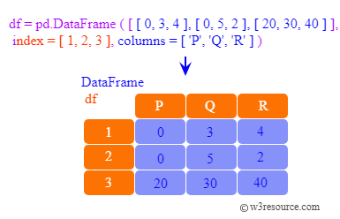
pandas.DataFrame
A pandas DataFrame can be created using the following constructor −
pandas.DataFrame( data, index, columns, dtype, copy)

Slide 5
The parameters of the constructor are as follows −
Sr.No | Parameter & Description
1 | data data takes various forms like ndarray, series, map, lists, dict, constants and also another DataFrame.
2 | index For the row labels, the Index to be used for the resulting frame is Optional Default np.arange(n) if no index is passed.
3 | columns For column labels, the optional default syntax is - np.arange(n). This is only true if no index is passed.
4 | dtype Data type of each column.
5 | copy This command (or whatever it is) is used for copying of data, if the default is False.

Slide 6
Create DataFrame
A pandas DataFrame can be created using various inputs like −
Lists
dict
Series
Numpy ndarrays
Another DataFrame

Slide 7
Create an Empty DataFrame
A basic DataFrame, which can be created is an Empty Dataframe.
DataFrame.ipynb

Slide 8
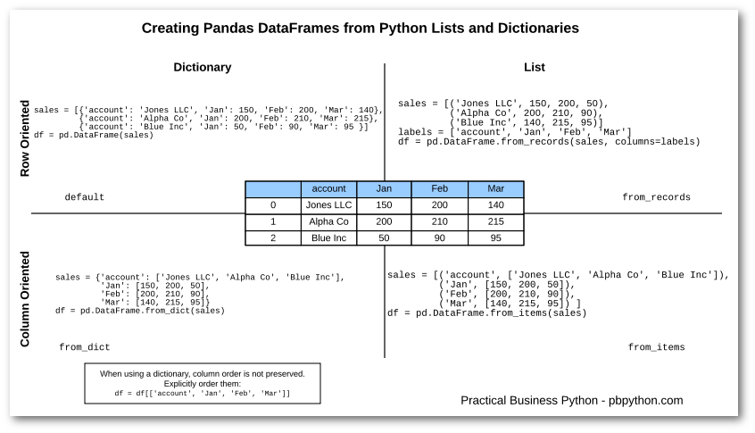
https://pbpython.com/pandas-list-dict.html

